Slide 1
Digital Steganography

Slide 2
Steganography is the science of hiding information in such a way that no one suspects the information exists.
With cryptography the information is known to exist, but it is encoded in such a way that only the intended recipient can read it.
Steganography is usually combined with cryptography.

Slide 3
Steganography has been used since ancient Greece.
These messages were sent by the German embassy in World War I. This is called a null cipher.
PRESIDENT'S EMBARGO RULING SHOULD HAVE IMMEDIATE NOTICE. GRAVE SITUATION AFFECTING INTERNATIONAL LAW. STATEMENT FORESHADOWS RUIN OF MANY NEUTRALS. YELLOW JOURNALS UNIFYING NATIONAL EXCITEMENT IMMENSELY.
APPARENTLY NEUTRAL'S PROTEST IS THOROUGHLY DISCOUNTED AND IGNORED. ISMAN HARD HIT. BLOCKADE ISSUE AFFECTS PRETEXT FOR EMBARGO ON BYPRODUCTS, EJECTING SUETS AND VEGETABLE OILS.
Taking the first letter in each word of message 1 or second letter in message 2 reveals the hidden text.
PERSHING SAILS FROM NY JUNE 1.
Digital media lend themselves to steganography because of the large amount of information in certain file types (bmp wav).

Slide 4
The simplest and most common type of steganography is LSB (least significant bit). The one’s bit of a byte is used to encode the hidden information.
Suppose we want to encode the letter A (ASCII 65 or binary 01000001) in the following 8 bytes of a carrier file.
01011101 11010000 00011100 10101100
11100111 10000111 01101011 11100011
becomes
01011100 11010001 00011100 10101100
11100110 10000110 01101010 11100011
Typical .wav file uses 16 bit sampling.
Is the difference between level 37,243 and 37,242 detectable by the human ear? Probably not.

Slide 5
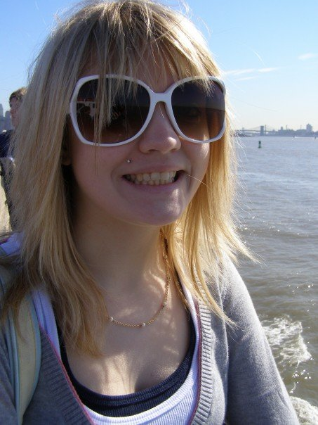
There is a bewildering array of steganography software available.
Example: http://home.comcast.net/~ebm.md/stego/softwarewindows.html
I used s-tools4.
The jpeg on the right is the payload picture which was embedded in other files.

Slide 6
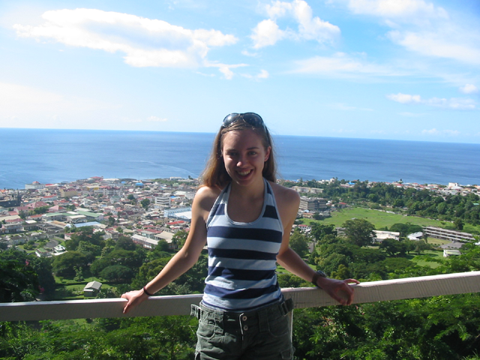

Carrier file. Left is original. Right is with embedded jpg.

Slide 7

Sound files (.wav) can also be used as carrier files.
This short .wav file contains the same embedded jpeg.

Slide 8
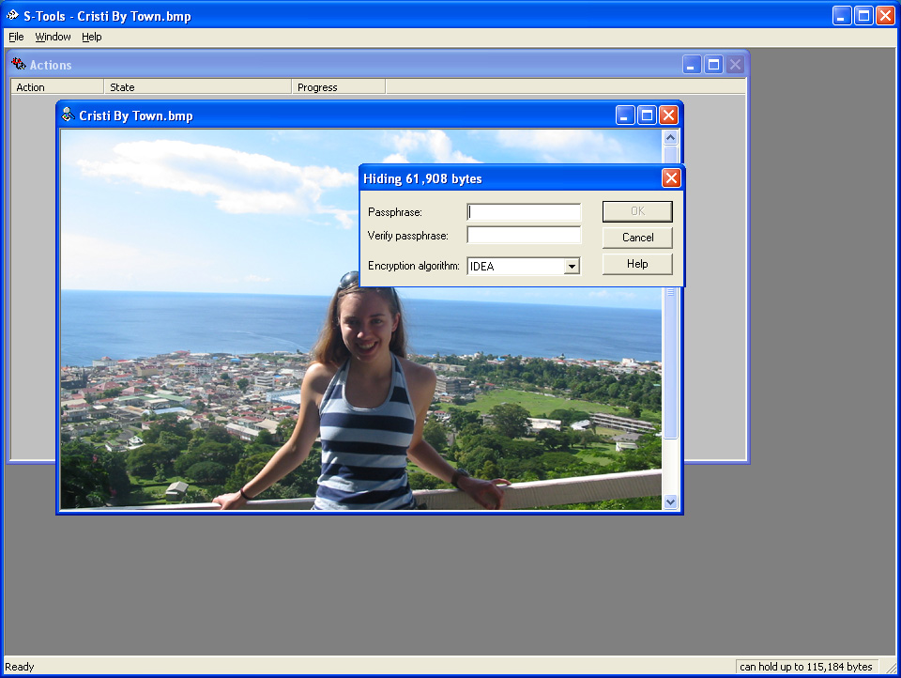
Screenshot of s-tools4

Slide 9
Variations of LSB
Use password as a seed for pseudo random number generator.
Use only those bytes separated by the value of the next random number to hide data.
Advantages - More difficult to detect and decode.
Disadvantage – Limits the number of bytes that are available for holding the payload.

Slide 10
Why is cryptography usually used in conjunction with steganography?
Provides an extra layer of security.
Makes the existence of a hidden message more difficult to detect.
The LSB of a digital audio or video file tends to resemble noise.
The most significant bits tend to be grouped in blocks. For example, the ocean background has a large block of bits where r = 0110xxxx g = 1010xxxx b = 1110xxxx
Thus when encoding this data in the LSB there will be a repeating pattern: 0110xxxx1010xxxx1110xxxx.
Encryption randomizes this data so it looks like noise again.

Slide 11
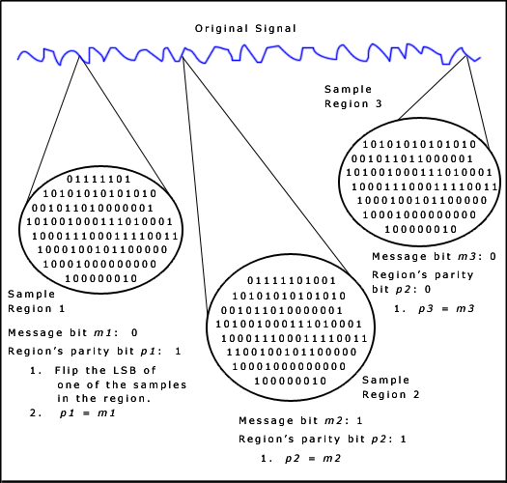
Many other types of digital steganography exist: polarity inversion, echo hiding, phase coding, cepstral hiding, perceptual hiding, signal timing, port knocking, parity coding, BPCS and spread spectrum.
Parity coding breaks the sound signal into areas then hides the message in the parity bit. If the parity does not match, it adjusts the LSB of one of the samples to get the required (even) parity.
Spread spectrum makes use of the fact that small changes are more difficult for the human eye or ear to detect at high energy levels (loud audio or bright video).
The message is hidden in those areas of the carrier file with the greatest energy.
BPCS is the most efficient. Embedded data can be over 50% the size of the carrier without affecting quality noticeably.

Slide 12
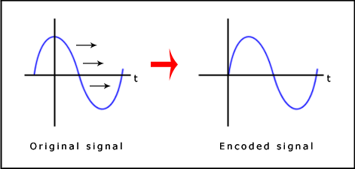
Phase coding makes use of the fact that the human ear is less sensitive to phase changes than amplitude changes.
Break the signal into a number of segments where the segment length (number of samples) equals the message length.
Apply DFT to each segment. Store phase and amplitudes in an array.
Encode the message into the phase vectors of the first segment only.
Adjust all subsequent segments to preserve the relative phase differences.
Reconstruct the wave by the inverse DFT.
The message is encoded in the first segment only, so this method is good only for small amounts of data, such as a digital watermark.

Slide 13
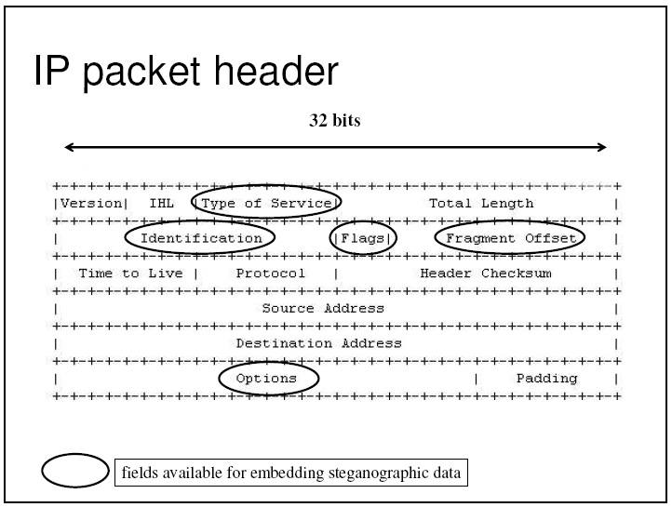
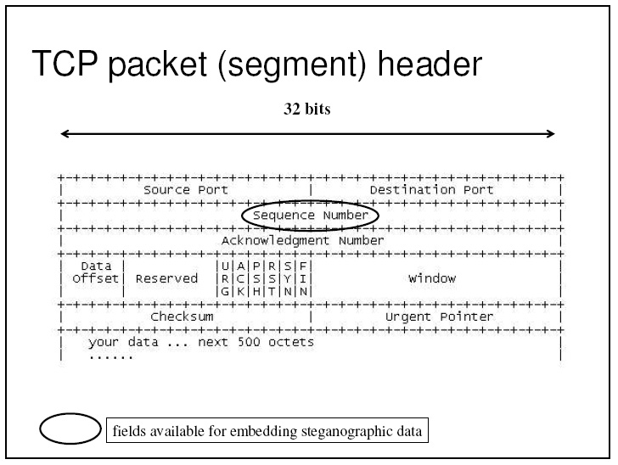
Network protocols can also be used to hide information.
TCP/IP protocols do not restrict:
IP Identification field value
“An internet header field carrying the identifying value assigned by the sender to aid in assembling the fragments of a datagram.”
TCP sequence number value
“When new connections are created, an initial sequence number (ISN) generator is employed which selects a new 32 bit ISN. The generator is bound to a ... clock ... [but] not tied to a global clock in the network, and TCPs may have different mechanisms for picking the ISN's.”

Slide 14
Uses of steganography
Digital watermarking.
Used in colour lasers to track the originating printer.

Slide 15
Sources
www.utd.edu/~bxt043000/cs4398_f7/Lecture17.ppt
http://cs.uccs.edu/~sasummer/cs591/SpreadSpectrum1.ppt
http://www-scf.usc.edu/~csci530l/slides/lab-steganography.pdf
http://www.securityfocus.com/infocus/1684
http://www.garykessler.net/library/steganography.html
http://home.comcast.net/~ebm.md/stego.html
http://www.jjtc.com/Steganography/
http://www.eece.maine.edu/~eason/steg/SPIE98.pdf
http://www.snotmonkey.com/work/school/405/methods.html

